Slide 1
Recitation 8: Memory management – a brief introduction

Slide 2
What is memory?
Qs to class:
What types of memory does an executing program have and what are its purposes?
What is dynamic memory allocation?
Tell me about a language you work with and whether it supports dynamic memory allocation. If so how?

Slide 3
Lettuce: Explicit References
newref(expr) → create a new cell in memory and set the initial content of the cell to whatever “expr” evaluates to.
deref(expr) → expr evaluates to a pointer/reference to a cell in memory then fetch the contents of that cell.
assignref(expr1, expr2) → expr1 is a reference to a cell in memory and expr2 is another value. Place the value of expr2 into the cell that expr1 points to.
Questions about these constructs?

Slide 4
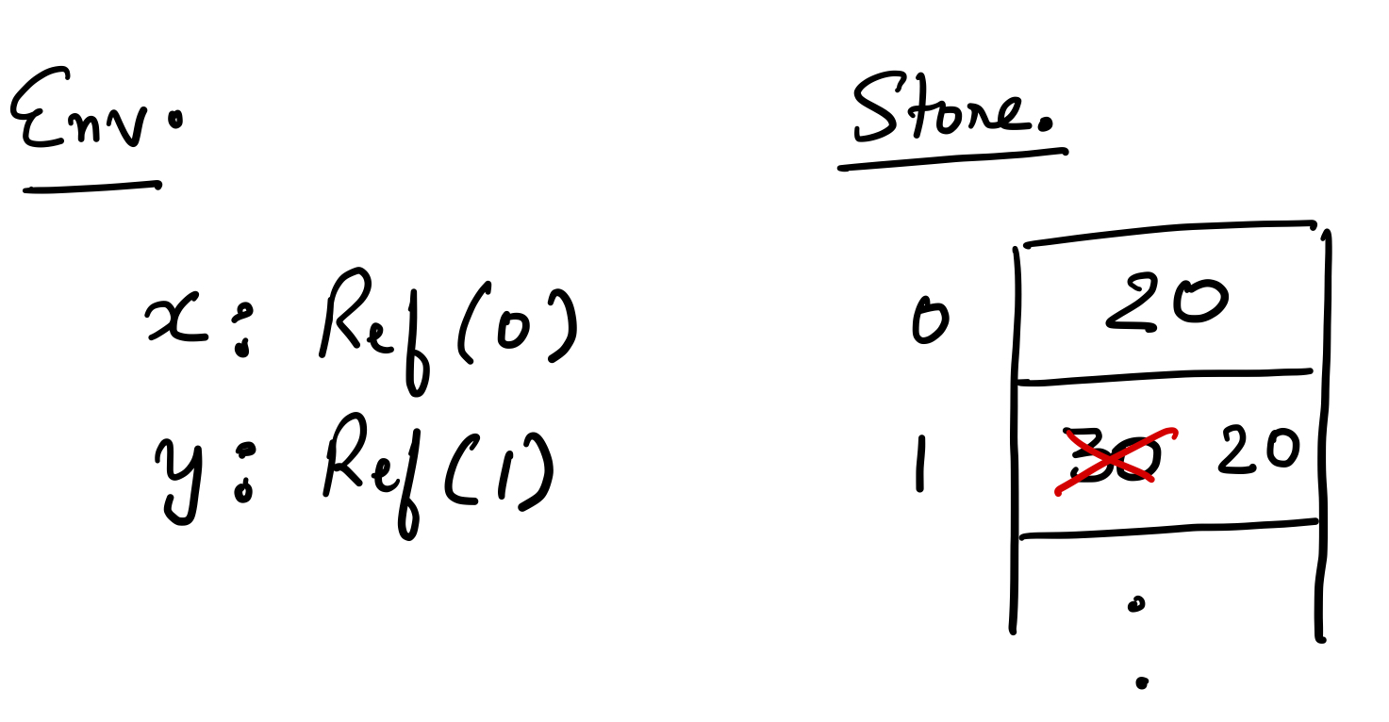
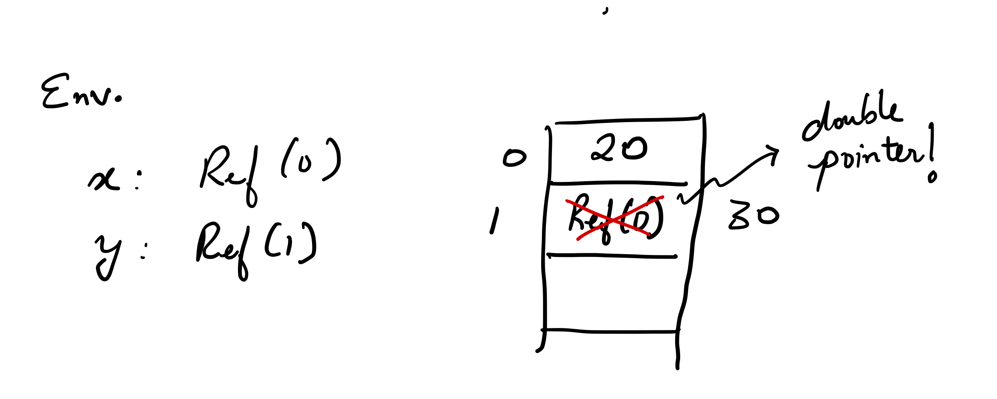
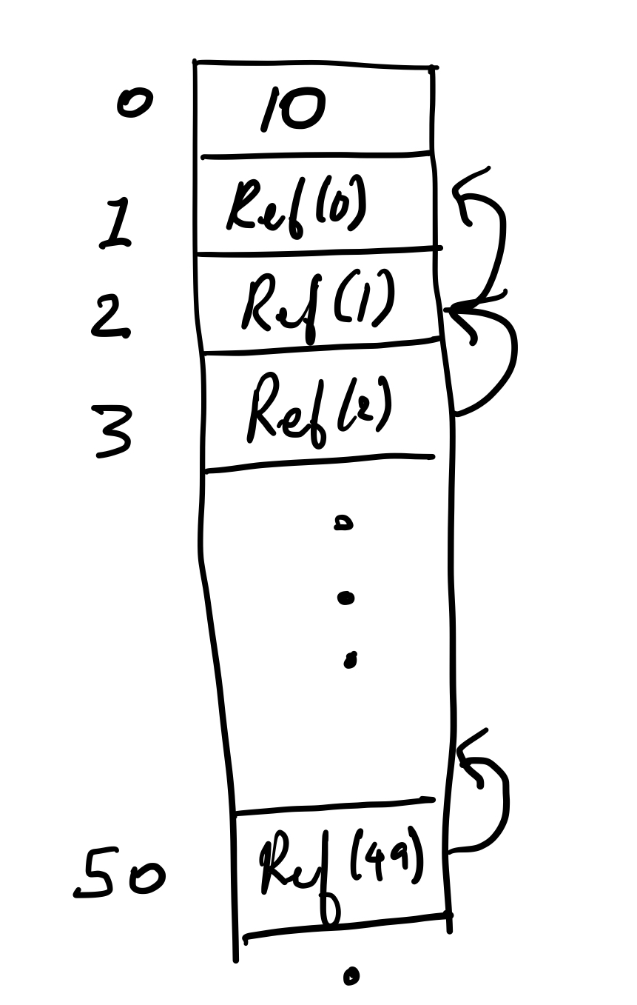
What do these program do? Draw a picture to visualize execution of each.
let x = newref(20) in
let y = newref(30) in
assignref(x, deref(y))
let x = newref(20) in
let y = newref(x) in
assignref(x, deref(y))
let rec crazy = function (n)
if (n <= 0)
then 10
else newref( f(n-1) )
in
crazy(50)

Slide 5
What about delete?
C/C++ have new/delete operators.
Why don’t we have one in Lettuce?
Memory management: programs ask for more memory as they execute and have memory that is no longer used.
If we did not delete/reclaim memory that is no longer needed, then we will inevitably run out.
Philosophy # 1: C/C++ Style
Philosophy # 2: Java/Scala/Python Style
What about Gangnam style??? ☺

Slide 6
Let’s delete Lettuce
Let us add a delete functionality to memory in Lettuce.
Over to notebook:
Syntax
Semantics
Problems??
Write some problematic programs?

Slide 7
Memory Self-Management issues
Allow programmers to manage memory through new/delete operations.
No checks when programmers access some memory through a pointer.
many errors can happen.
These errors have led to serious security vulnerabilities including some you have heard of such as HEARTBLEED.

Slide 8
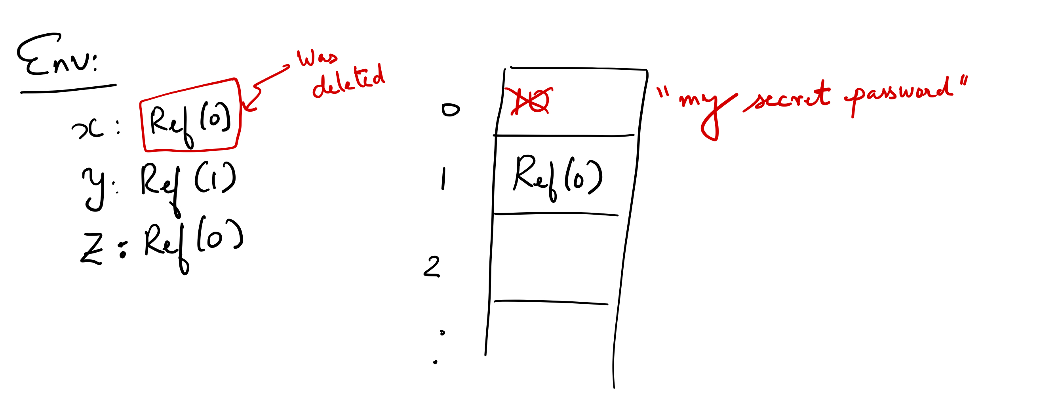
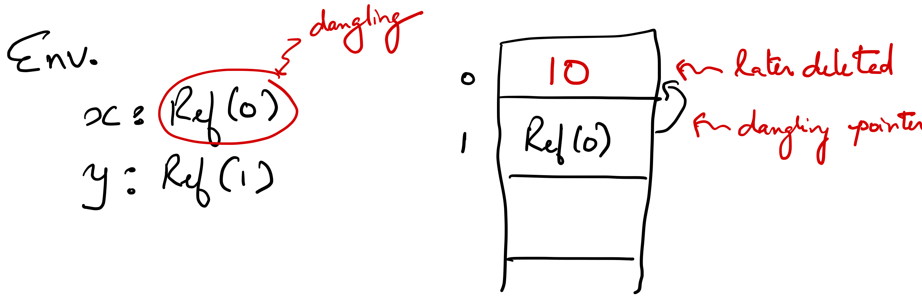
Dangling Pointers
let x = newref (10) in
let y = newref(x) in
let _ = deleteref(x) in
let z = newref(“my secret password”) in
deref(deref(y))
let x = newref (10) in
let y = newref(x) in
let _ = deleteref(x) in
deref(deref(y))

Slide 9
Memory Leaks
let ref leakyLeeks = function (n)
if ( n <= 1)
then 1
else (
let var = newref (n) in
let rcall = leakyLeeks(n-1) in.
deref(var) * rcall
) in
leakyLeeks (5)

Slide 10

Garbage Collection
The programming language runtime takes care of managing memory for you.
Advantages: no dangling pointers, no leaks, no mess, no fuss.
Disadvantages: takes extra time, overhead on simple operations like assignments, function calls, etc.. Restricts programmer freedom.

